Slide 1
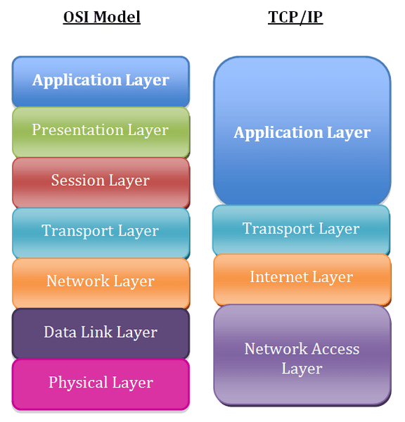

Application Layer
Network communication
Send and receive data
Interface
Notes:
Application Layer of OSI (Open System Interconnection) model, is the top layer in this model and takes care of network communication. It provides the functionality to send and receive data from users. It acts as the interface between the user and the application.

Slide 2
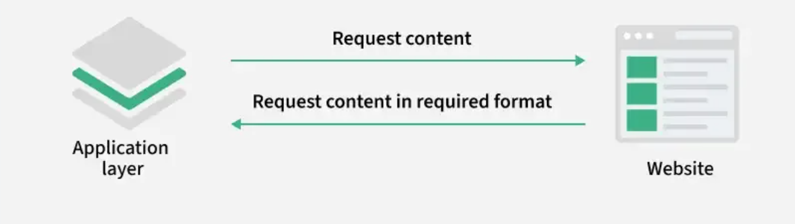
Data Representation
Presenting information
Converts user-entered information
ASCII, JPEG, HTML
Notes:
1. Data Representation
Ensures that data is presented in a format that both the sender and receiver can understand.
Converts user-entered information into a standard format before transmission and interprets received data back into a user-friendly form.
Example: Converting text, images or files into network-compatible formats like ASCII, JPEG or HTML.

Slide 3
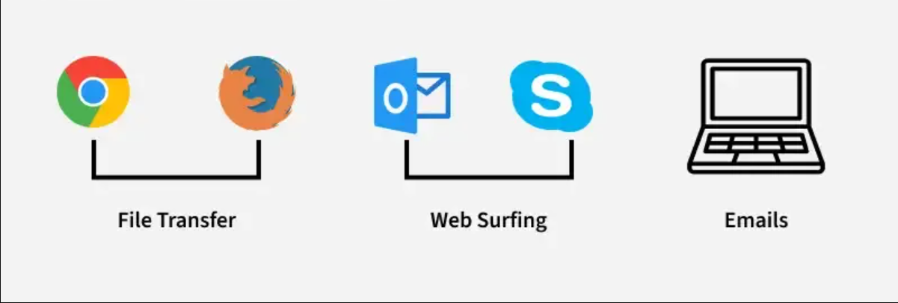
Network Service Access
Provides access to network services
Application interact with network
Notes:
2. Network Service Access
Provides access to various network services directly to the user.
Allows applications like email, file transfer and remote login to interact with the underlying network.
Example: Using email clients (Outlook, Gmail) to access mail services or using FTP to download/upload files.
3

Slide 4
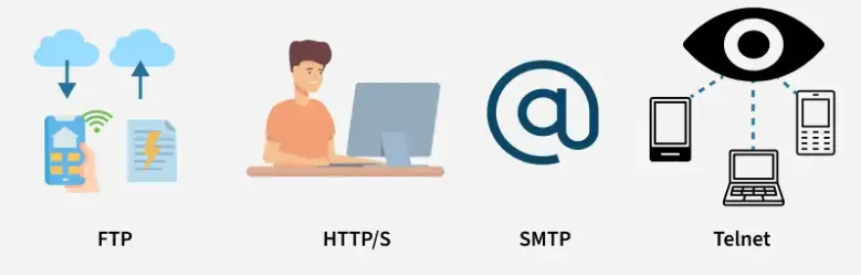
Application Protocals
Rules and procedures
formatting, data exchange
HTTP, FTP, SMTP, DNS
Notes:
3. Application Protocols
Defines a set of rules and procedures that applications use to communicate over a network.
These protocols handle message formatting, data exchange and service requests.
Example: HTTP for web browsing, FTP for file transfer, SMTP for emails, DNS for domain name resolution.
4

Slide 5
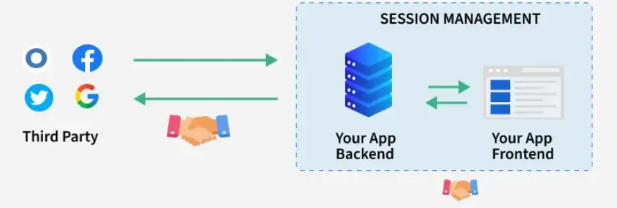
Session Management
Manage sessions between applications
Synchronization
Cookies
Notes:
4. Session Management
Establishes, manages and terminates communication sessions between applications.
Maintains synchronization during data exchange and ensures a proper connection is closed after the communication ends.
Example: Logging into a remote server using Telnet or SSH, where a session is created and terminated after logout.
5

Slide 6
Transport Layer
Communication between applications
Deliver date reliably
Transfer in correct order
Notes:
The Transport Layer ensures end-to-end communication between applications on different hosts. It sits between the Network Layer (which delivers packets to the right machine) and the Session Layer (which manages communication sessions). Its main job is to deliver data reliably, efficiently, and in the correct order.
1

Slide 7
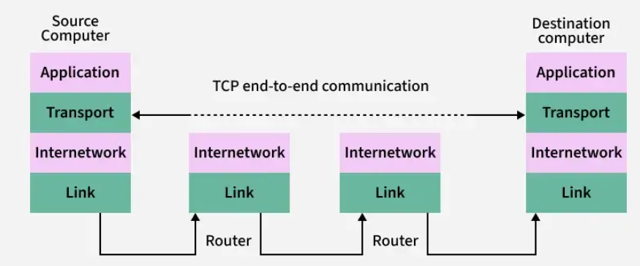
End-to-end communication
Sender and receiver
Routers, transportation
Computers
Notes:
Everyday example 📦
Imagine you send a package to a friend in another city.
You pack the box and write the address
The package goes through post offices, trucks, and delivery centers
Your friend opens the package at the end
👉 The post offices don’t open the box or change what’s inside
👉 They only move it closer to the destination
That’s end-to-end communication.
2

Slide 8
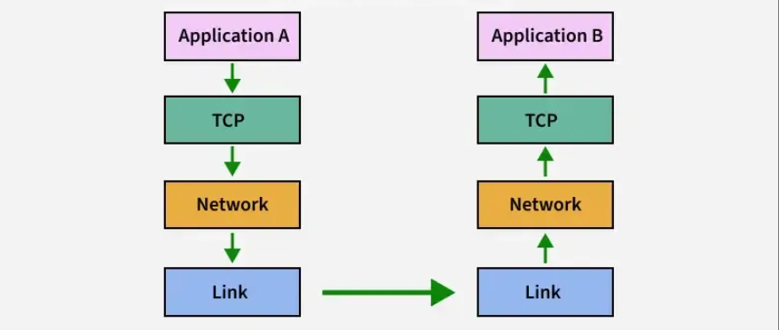
Flow Control
Prevent receiver overload
Speed handling
“Please wait”
Notes:
Flow control means not sending data faster than the receiver can handle.
hink of pouring water into a bottle:
If you pour slowly, the bottle fills nicely ✅
If you pour too fast, water spills ❌
Flow control is like adjusting the speed of pouring so nothing spills.
In computer terms 💻
One computer is sending data
The other computer is receiving data
If the sender sends too fast, the receiver’s memory can get full
👉 Flow control makes the sender slow down when needed
7

Slide 9
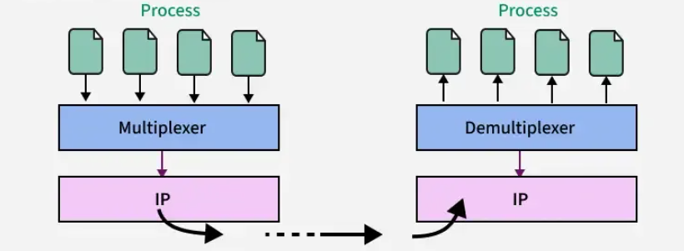
Multiplexing and Demultiplexing
WhatsApp, YouTube, Email
Many -> One
Mail-building
One -> Many
Notes:
Simple example 🚕
Imagine a single taxi:
It picks up multiple passengers
All share the same ride
Each passenger has a different destination
That’s multiplexing.
In computer terms 💻
Your phone runs WhatsApp, YouTube, Email at the same time
All their data goes into one internet connection
Each app’s data is tagged with a port number
Demultiplexing 📥 (one → many)
Demultiplexing means delivering incoming data to the correct app.
Simple example 🏢
Imagine a mailroom in an office:
All mail comes to one building
The mailroom looks at room numbers
Delivers each letter to the right person
That’s demultiplexing.
In computer terms 💻
Data arrives at your computer
The system checks the port number
Sends the data to the correct application
8

Slide 10
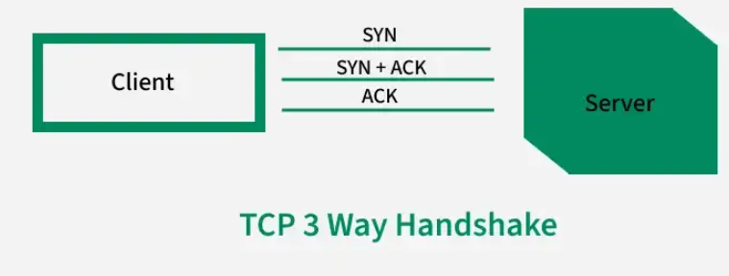
Connection Establishment
Making a phone call
Make the other side is reachable
SYN, SYN-ACK, ACK
Server - Client
Notes:
Simple real-life example ☎️
Think of making a phone call:
You: “Hello?”
Friend: “Yes, I’m here.”
You: “Great, let’s talk.”
Only after this do you start the real conversation.
That’s connection establishment.
In computer terms 💻
Before two computers send data reliably, they:
Check that the other side is reachable
Agree to start communication
Prepare to send and receive data safely
This is mainly done by TCP.
TCP Connection Establishment (3-way handshake 🤝)
TCP uses three simple steps:
SYN – “Can I talk to you?”
SYN-ACK – “Yes, I hear you.”
ACK – “Great, let’s start.”
After this, the connection is established, and data can flow.
9

Slide 11
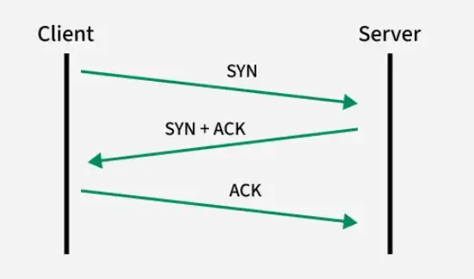
Connection Termination
Ending phone call
No more data to be sent
Release memory and resources
FIN, ACK, FIN, ACK
Notes:
Simple real-life example ☎️
Think of ending a phone call:
You: “I’m done talking.”
Friend: “Okay, I know.”
Friend: “I’m done too.”
You: “Okay, goodbye.”
Now both sides hang up cleanly, with no confusion.
In computer terms 💻
When two computers finish exchanging data:
They tell each other no more data will be sent
They release memory and resources
They avoid half-open or broken connections
This is mainly done by TCP.
TCP Connection Termination (4-step process)
FIN – “I’m done sending data.”
ACK – “I got that message.”
FIN – “I’m also done.”
ACK – “Got it. Goodbye.”
After this, the connection is closed safely.
10

Slide 12
Reliable Data Delivery
Everything delivered correctly?
In sequence
No duplicates
Notes:
It ensures all data is delivered correctly, in sequence, and without duplication. TCP
11

Slide 13
Quality of Service
Performance
Priority
Data: Video calls or file transfer
Memory usage
Notes:
It ensures priority and performance for specific types of data, like video calls or file transfer
Where QoS is used
Video calls (Zoom, Teams)
Online gaming
Voice calls (VoIP)
Corporate and ISP networks
What QoS controls
Delay (latency) → How long data takes to arrive
Jitter → Variation in delay (very bad for voice/video)
Bandwidth → How much data can be sent
Packet loss → Dropped data
Simple real-life example 🚑🚦
Imagine a road:
Ambulances get priority
Buses go next
Regular cars wait if traffic is heavy
QoS works the same way for data.
12

Slide 14
Network Layer
End to end packet delivery
Multiple interconnected networks
Notes:
Network Layer is the third layer from the bottom (Layer 3) and the fifth layer from the top in the OSI (Open Systems Interconnection) Model. It is responsible for ensuring end-to-end packet delivery across multiple interconnected networks.
6

Slide 15
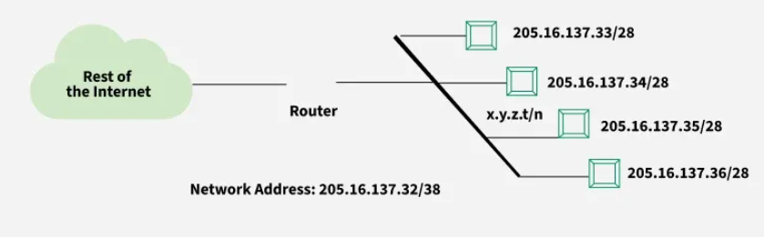
Assigning Logical Address
Each device had an IP
Identified on the same network
DHCP
Notes:
At the Network Layer, assigning a logical address means giving each device an IP address so it can be identified on the network.
Simple real-life example 🏠
Think of:
House number + street + city
Even if you change houses, you get a new address.
An IP address works the same way:
It tells where a device is located
It can change when you join a new network
What is a logical address? 🌍
A logical address = IP address
Assigned by the Network Layer
Used to identify devices across different networks
Helps routers find the destination
Who assigns the logical address?
Automatically by DHCP
Or manually by a network administrator
Why logical addressing is needed
Physical (MAC) addresses work only locally
IP addresses allow global communication
Helps in routing and delivery
Logical address vs Physical address
Logical Address (IP)Physical Address (MAC)Given by networkBuilt into deviceCan changeFixedUsed by routersUsed inside local network
One-line summary ⭐
The Network Layer assigns logical (IP) addresses so devices can be uniquely identified and reached across networks.
What DHCP does 💻
When your phone or laptop connects to a network, DHCP:
Gives it an IP address
Tells it the gateway (where to send data outside)
Gives DNS details (how to find websites)
All this happens automatically.
Simple real-life example 🏨
Think of a hotel:
You walk in without a room number
The receptionist automatically gives you a room
When you leave, the room can be given to someone else
DHCP works the same way for computers.
7

Slide 16
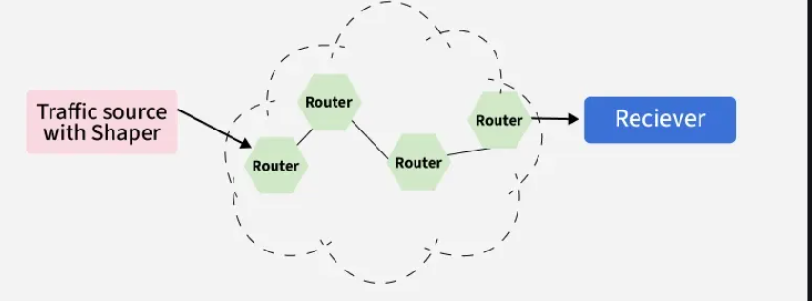
Packetizing
Breaking big message into small
Each box destination address
Easy to fix
Notes:
Simple real-life example 📦
Imagine you want to send a big book by mail:
You don’t send it as one huge box
You split it into several small boxes
Each box has:
Destination address
Box number (1 of 5, 2 of 5, etc.)
That splitting is packetizing.
In computer terms 💻
A message (like a video or file) can be very large
The network breaks it into small packets
Each packet travels independently
At the destination, packets are put back together
Why packetizing is important
Easier to send over the network
If one packet is lost, only that packet is resent
Multiple users can share the network efficiently
Reduces congestion and delay
What each packet contains
Source address
Destination address
Packet number
A piece of the original data
Where packetizing happens
Mainly at the Network Layer
Also involves the Transport Layer
15

Slide 17
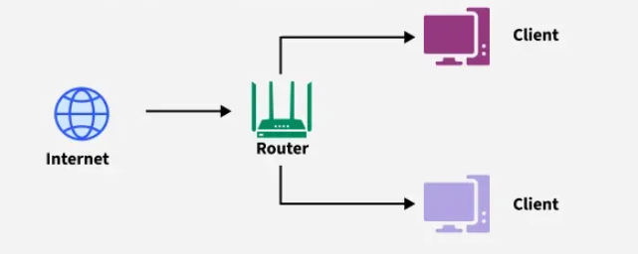
Forwarding
Happens in every router
Data is broken into packets
Next destination
Notes:
Simple real-life example 🧭
Imagine you’re traveling to a far city:
At each road junction, a sign tells you which road to take next
You don’t plan the whole trip there
You just follow the next direction
That decision at each junction is forwarding.
In computer terms 💻
Data is broken into packets
Each packet reaches a router
The router looks at the destination IP address
Using a forwarding table, it sends the packet to the next hop
Important points about forwarding
Happens at every router
Is a local decision
Very fast
Part of the Network Layer
Forwarding vs Routing (simple)
ForwardingRoutingMoves packet to next hopDecides best pathLocal actionGlobal planningFastSlower
One-line summary ⭐
Forwarding is the step-by-step movement of packets from one router to the next toward the destination.
16

Slide 18
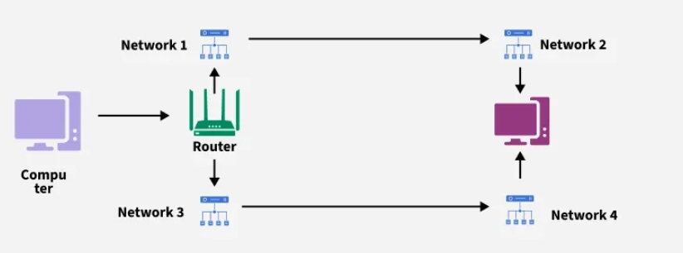
Routing
Google Maps
Fastest route
RIP, OSPF, BGP
Notes:
Simple real-life example 🗺️
Imagine you want to go to another city:
You check Google Maps
It shows several routes
You choose the fastest or shortest route
That route selection is routing.
In computer terms 💻
Data travels through many routers
Routers work together to:
Learn about the network
Decide which path is best
This information is stored in a routing table
What routing does
Finds the best path
Avoids broken or congested links
Updates paths when the network changes
Routing protocols (examples)
RIP
OSPF
BGP
(You don’t need details yet—just the idea.)
Routing vs Forwarding (quick recall)
RoutingForwardingChooses the pathMoves packetsNetwork-wideLocal actionSlower decisionVery fast
Where routing happens
Network Layer
Inside routers
One-line summary ⭐
Routing is the process of choosing the best path for data to travel across a network.
Final one-line summaries ⭐
RIP: counts routers
OSPF: chooses fastest path
BGP: runs the Internet
20

Slide 19
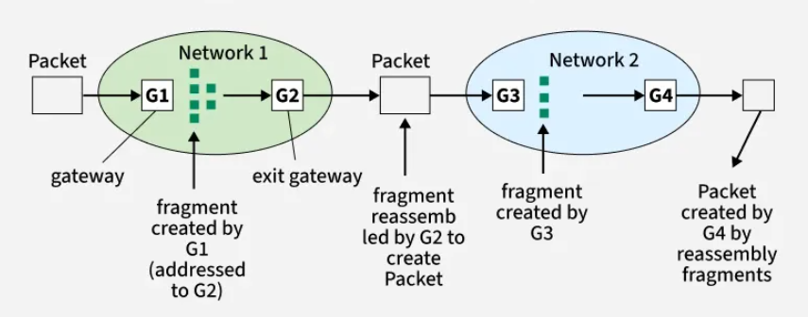
Fragmentation And Reassembly Of Packets
Break then put together
Travel separately
Prevents packet loss
Notes:
Simple real-life example 📦
Imagine you have a big suitcase, but the bus luggage space is small:
You break the suitcase into smaller bags → fragmentation
At the destination, you put everything back together → reassembly
In computer terms 💻
Different networks allow different packet sizes (called MTU)
If a packet is too large, the network layer:
Breaks it into smaller fragments
Each fragment travels separately
The receiver reassembles them into the original packet
Fragmentation
Done at the Network Layer
Each fragment has:
Fragment number
Offset (position in original packet)
Allows packets to pass through smaller networks
Reassembly
Done only at the destination
Fragments are:
Collected
Ordered correctly
Joined back together
Why fragmentation is needed
Ensures packets fit through all networks
Prevents packet loss due to size limits
Allows smooth communication across different networks
Important points to remember
Fragmentation happens during transmission
Reassembly happens at the receiver
Routers do not reassemble packets
One-line summary ⭐
Fragmentation breaks large packets into smaller pieces, and reassembly puts them back together at the destination.
17

Slide 20
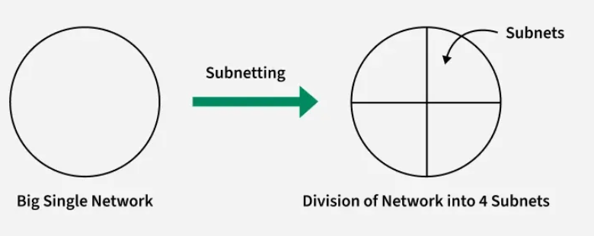
Logical Subnetting
Separate big network into small
Faster, safer and easier
Big campus : Admin, Library…
Notes:
Simple real-life example 🏢
Imagine a college campus:
One big campus
Separate buildings for:
Admin
Library
Students
Staff
All are part of the same campus, but divided logically for better organization.
That division is logical subnetting.
In computer terms 💻
A company gets one IP network
Instead of using it as one big group, it is divided into smaller sub-networks
Each subnet:
Has its own range of IP addresses
Handles its own traffic
Why logical subnetting is used
✔ Reduces network traffic
✔ Improves performance
✔ Increases security
✔ Easier network management
✔ Saves IP addresses
How subnetting works (conceptually)
Network part → identifies the main network
Host part → identifies devices
Subnet mask → decides how big each subnet is
Example idea (no math yet 😊):
One network → split into 4 smaller networks
Each used by a different department
Important points to remember
Subnetting is logical, not physical
Done at the Network Layer
Routers are used to connect subnets
Devices in different subnets need a router to communicate
One-line summary ⭐
Logical subnetting is dividing one large network into smaller, manageable networks using IP addresses.
18

Slide 21
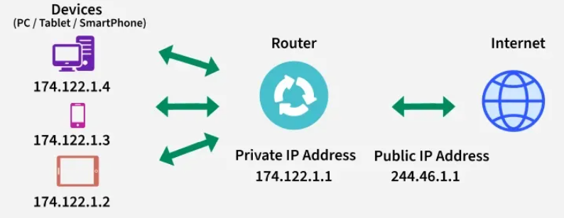
Network Address Translation
Many to one (NAT)
Static NAT
Dynamic NAT
PAT
Notes:
Simple real-life example 🏠📬
Imagine an apartment building:
The building has one main address
Inside, each apartment has its own room number
When mail comes:
The building address is used outside
Inside, mail is delivered to the correct room
That’s how NAT works.
In computer terms 💻
Devices in your home (phone, laptop, TV) use private IP addresses
Your router has one public IP address
NAT:
Changes private IPs → public IP when sending data out
Changes public IP → correct private IP when data comes back
Why NAT is needed
✔ Saves public IP addresses
✔ Allows many devices to share one Internet connection
✔ Adds a basic level of security
✔ Commonly used in homes and offices
How NAT works (very simply)
Your laptop sends data to a website
Router replaces your private IP with its public IP
Website replies to the public IP
Router sends the reply back to your laptop
All of this happens automatically.
Types of NAT (just the idea)
Static NAT – one private ↔ one public
Dynamic NAT – private ↔ any available public
PAT (Port Address Translation) – many devices ↔ one public IP (most common)
One-line summary ⭐
NAT lets multiple private devices access the Internet using a single public IP address.
19

Slide 22
Data Link Layer
End to end packet delivery
Multiple interconnected networks
Notes:
The data link layer is the second layer from the bottom in the OSI (Open System Interconnection) network architecture model.
Responsible for the node-to-node delivery of data within the same local network.
Major role is to ensure error-free transmission of information.
Also responsible for encoding, decoding, and organizing the outgoing and incoming data.
Considered as the most complex layer of the OSI model as it hides all the
6

Slide 23
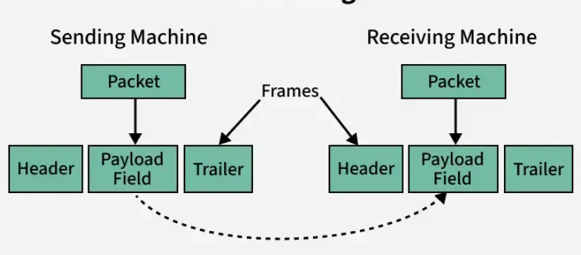
Framing
Extra information
Physical link
Frames and headers
Notes:
Simple real-life example 📦
Imagine sending glass items:
You pack them in a box
Add labels (to/from)
Add protection so they don’t break
That packing is framing.
In computer terms 💻
Raw data alone is hard to send
The Data Link Layer:
Breaks data into frames
Adds headers and trailers
Makes sure data is sent correctly between two devices
What a frame contains
Sender address
Receiver address
Data
Error-checking information
Why framing is important
Tells where a frame starts and ends
Helps detect errors
Allows correct delivery to the next device
Where framing happens
Data Link Layer
Works hop-by-hop
Changes at every link
7

Slide 24
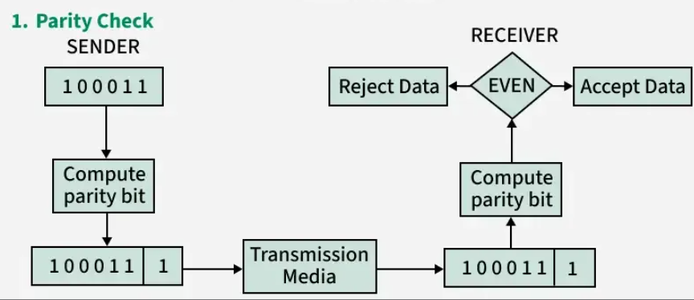
Error Detection
Is data damaged?
Is matching numbers?
Curruption
Notes:
Simple real-life example ✉️
Imagine sending a letter with a special code at the end:
You write the letter
Add a check number
Your friend recalculates the number when it arrives
If the numbers don’t match → the letter was changed or damaged.
That’s error detection.
In computer terms 💻
Data can get corrupted due to noise or interference
The sender adds extra checking information
The receiver checks the data
If there’s a mismatch, an error is detected
Where error detection happens
Mainly in the Data Link Layer
Also used in the Transport Layer
Works hop-by-hop
Common error detection methods
Parity check
Checksum
CRC (Cyclic Redundancy Check)
Important to remember
Error detection finds errors
It does not fix errors
Fixing is done by retransmission
15

Slide 25
Error Correction
Fixing errors
Forward Error Correction
Retransmission
Hamming Code
Notes:
Simple real-life example ✏️
Imagine your friend sends you a sentence:
“I l0ve y0u”
Even without asking again, you can understand it should be:
“I love you”
You corrected the error yourself — that’s error correction.
In computer terms 💻
Noise can change bits (0 ↔ 1)
With error correction:
Receiver can detect the error
And correct it automatically
No need to ask the sender to resend
Two ways error correction is done
1. Forward Error Correction (FEC) ➡️
Extra information is sent with data
Receiver uses it to fix errors
Used when retransmission is costly or slow
(satellite, video streaming)
2. Retransmission (ARQ) 🔁
Receiver detects error
Asks sender to send again
Used in reliable protocols like TCP
Common error correction methods
Hamming code
Reed–Solomon code
Convolutional codes
Where error correction happens
Data Link Layer
Transport Layer
Physical Layer (some systems)
Error detection vs error correction
Error DetectionError CorrectionFinds errorsFinds and fixes errorsNeeds retransmissionNo retransmission neededLess complexMore complex
1. Hamming Code 🧩
Simple idea
Hamming code adds a few extra check bits so the receiver can:
Find where the error happened
Fix one wrong bit
Everyday example
Imagine a sentence where you know exactly which letter is wrong and can replace it immediately.
Key points
Corrects 1-bit error
Detects 2-bit errors
Simple and fast
Used in computer memory (RAM)
Best for
Small errors, short data
16

Slide 26
Flow Control
Prevent receiver overload
Speed handling
“Please wait”
Notes:
Flow control means not sending data faster than the receiver can handle.
hink of pouring water into a bottle:
If you pour slowly, the bottle fills nicely ✅
If you pour too fast, water spills ❌
Flow control is like adjusting the speed of pouring so nothing spills.
In computer terms 💻
One computer is sending data
The other computer is receiving data
If the sender sends too fast, the receiver’s memory can get full
👉 Flow control makes the sender slow down when needed
7

Slide 27
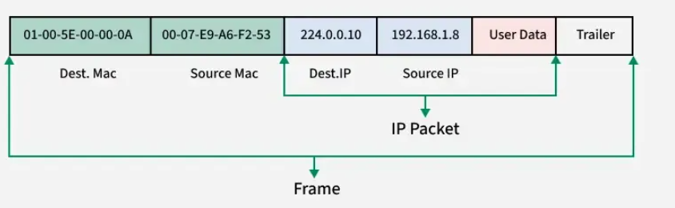
Addressing
Give a unique address
Sender to Receiver
Notes:
Simple real-life example 🏠
When you send a letter:
You write the receiver’s home address
Without the address, the letter gets lost
In the same way, computers need addresses so data reaches the correct device.
In computer networks 💻
Every device on a network has an address so:
Data knows who sent it
Data knows who should receive it
Types of addressing (simple view)
1. Physical Address (MAC address) 🪪
Like a person’s fingerprint
Fixed and unique for every device
Used for delivery within the same network
2. Logical Address (IP address) 🌍
Like a home address
Can change when you move to a new network
Used to deliver data across the internet
Why addressing is important
Prevents data from going to the wrong device
Helps routers choose the correct path
Allows millions of devices to communicate
How data uses addresses
Sender puts destination address on data
Network reads the address
Data is forwarded step by step
Receiver accepts data meant for it
18

